Slide 1



Crop and Fertilizer Recommendation System

Slide 2

Learning Objectives
Understand the importance of precision agriculture in optimizing crop yield.
Analyze key soil parameters (Nitrogen, Phosphorus, Potassium, pH, etc.) to recommend the best crops.
Implement machine learning models for intelligent fertilizer recommendations.
Enhance decision-making for farmers by providing data-driven insights.
Develop an automated recommendation system to improve productivity and sustainability.
Utilize data visualization and predictive analytics for better agricultural practices.
GOAL

Slide 3
Tools and Technology used
🔹 Programming Languages: Python 🔹 Libraries & Frameworks: Pandas, NumPy, Scikit-learn, Matplotlib, Seaborn 🔹 Machine Learning Models: Decision Tree 🔹 Data Preprocessing: StandardScaler, Label Encoding, Feature Engineering 🔹 Development Tools: Jupyter Notebook, Visual Studio

Slide 4
Methodology
📌 Data Collection
Gathered crop and fertilizer datasets from reliable sources.
Preprocessed data by handling missing values and normalizing features.
📌 Feature Engineering
Selected key parameters like Nitrogen, Phosphorus, Potassium (NPK), temperature, humidity, and soil type.
Encoded categorical variables for model compatibility.
📌 Model Training & Evaluation
Implemented Decision Tree for crop recommendation.
Used StandardScaler for feature normalization.
Evaluated models using accuracy, precision, and recall.
📌 Fertilizer Recommendation System
Applied classification techniques to suggest the best fertilizer based on soil and crop conditions.
Compared multiple algorithms to optimize performance.

Slide 5
Problem Statement:
🚜 Agricultural Challenges:
Farmers struggle to choose the right crop based on soil and weather.
Incorrect fertilizer use leads to low yield and soil degradation.
Need for a data-driven system to improve decision-making.

Slide 6
Solution:
🌱 AI-Powered Crop & Fertilizer Recommendation System
Uses machine learning to predict the best crop for given soil and weather conditions.
Recommends the optimal fertilizer based on soil nutrients.
Improves yield, reduces waste, and promotes sustainable farming.

Slide 7
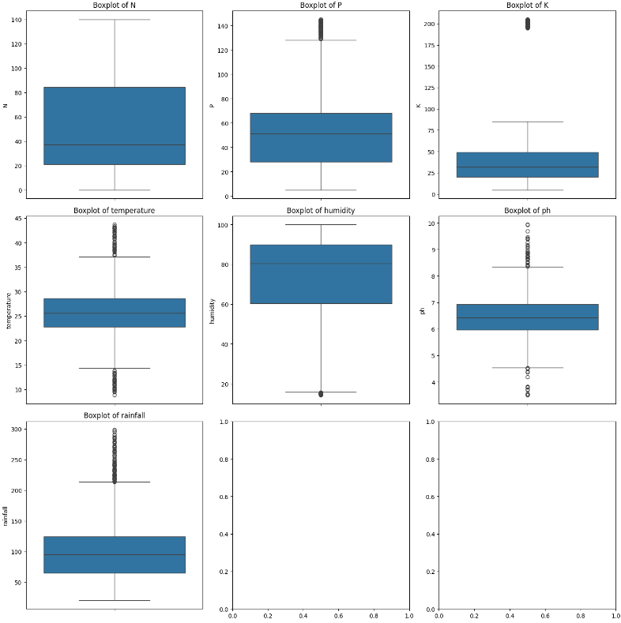
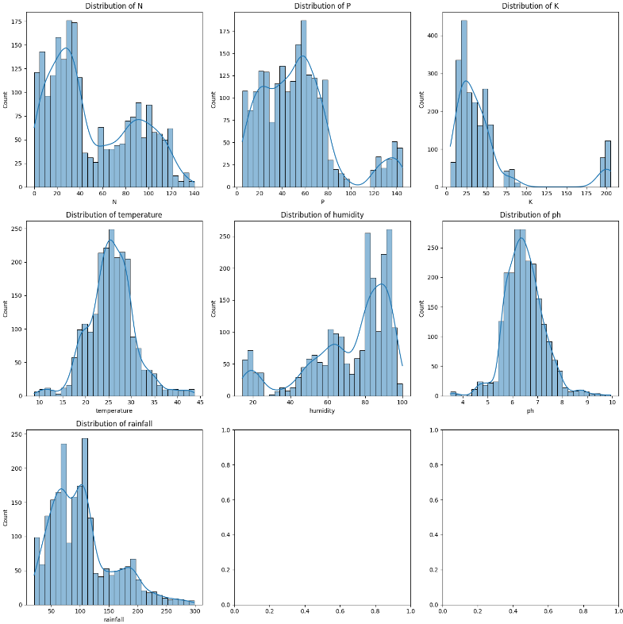
Screenshot of Output:

Slide 8
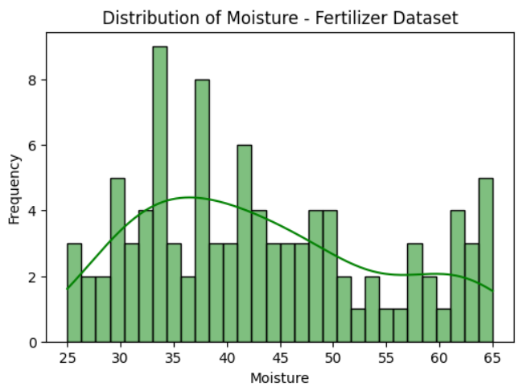
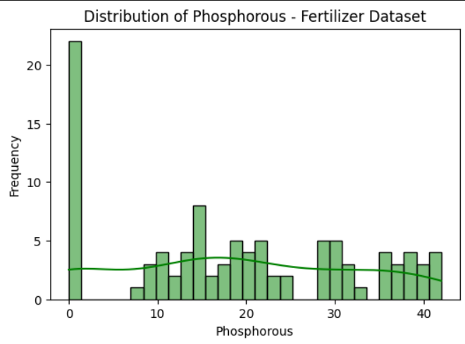

Slide 9
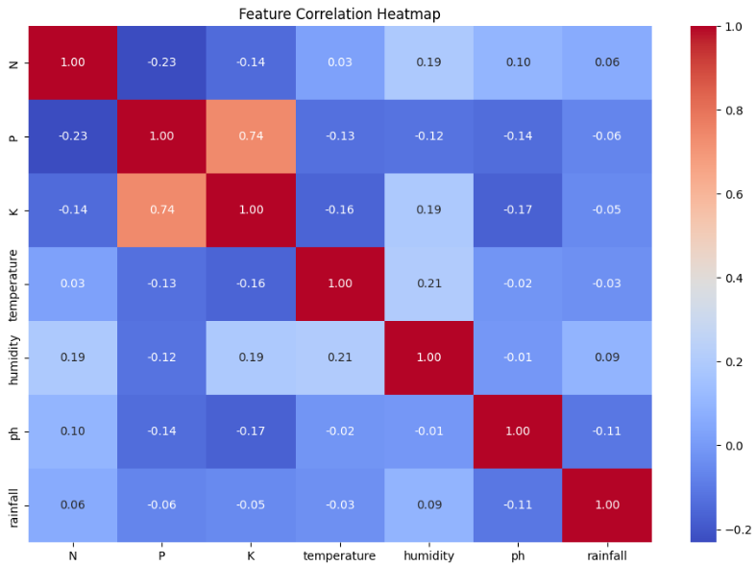

Slide 10
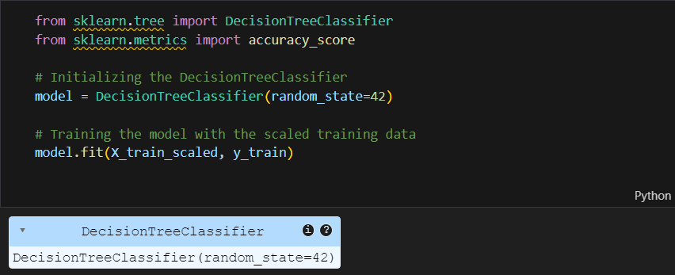
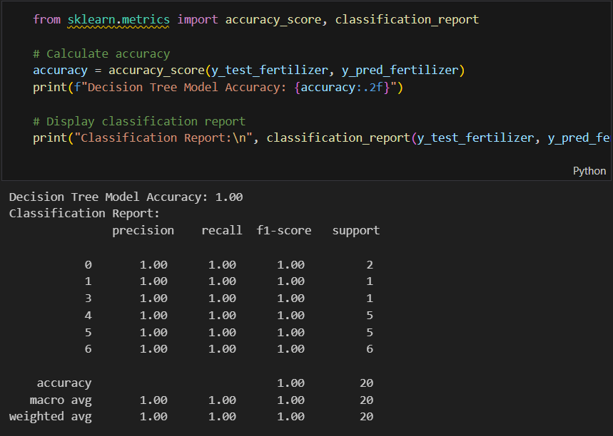

Slide 11
Conclusion:
🚀 The Crop & Fertilizer Recommendation System enhances agricultural productivity by leveraging machine learning to provide data-driven insights.
🌱 It helps farmers make informed decisions, leading to better crop yield, efficient resource utilization, and sustainable farming practices.
✅ This solution has the potential to revolutionize modern agriculture, ensuring higher efficiency and profitability while minimizing environmental impact.

